Slide 1

TECHTRONIX INNOVATIONS: A DEEP DIVE INTO SALES PERFORMANCE & MARKET OPPORTUNITES
By Nathalie Iredje

Slide 2

TABLE OF CONTENT
Business Overview
Business problems & Objectives
Data Analysis & Findings
Sales Performance, Customer Insights, Inventory Management & Profitability
Expansion/Growth Opportunities
4. Action Plans
5. Conclusion

Slide 3

BUSINESS OVERVIEW
Techtronix Innovations is a leading force in the high-tech industry, renowned for its cutting-edge microchips and advanced robotic systems. They power a diverse range of industries, from the autonomous vehicles that navigate our roads to the smart homes that enhance our daily lives. Their microchips are synonymous with speed, efficiency, and reliability, while their robotics solutions are revolutionizing manufacturing, logistics, and healthcare. Techtronix are committed to pushing the boundaries of innovation, developing groundbreaking technologies that transform industries, improve lives, and shape the future.

Slide 4
BUSINESS PROBLEMS & OBJECTIVES
Techtronix Innovations faces significant challenges in maximizing its sales potential. These challenges include:
Unpredictable Demand: Fluctuating market conditions make it difficult to accurately forecast sales, leading to inventory imbalances and missed opportunities.
Inefficient Production Planning: Misalignments between production capacity and actual demand result in excess inventory, production delays, and increased costs.
Limited Market Visibility: Identifying and capturing new market opportunities in a dynamic and competitive landscape remains a significant issue.
This analysis aims to address these challenges by:
Understanding Sales Performance: Identifying key sales trends, identifying top-performing products and markets, and pinpointing areas for improvement.
Gaining Customer Insights: Segmenting customers to understand their purchasing behavior, preferences, and geographic distribution.
Optimizing Inventory Management: Aligning production with actual demand to minimize inventory costs and maximize resource utilization.
Improving Profitability: Analyzing product profitability and identifying cost-reduction strategies to enhance overall business margins.
Identifying New Market Opportunities: Exploring new markets and customer segments to drive future growth and expand the company's reach.

Slide 5

DATA ANALYSIS & FINDINGS (A) Sales Performance, Customer Insights, Inventory Management & Profitability

Slide 6
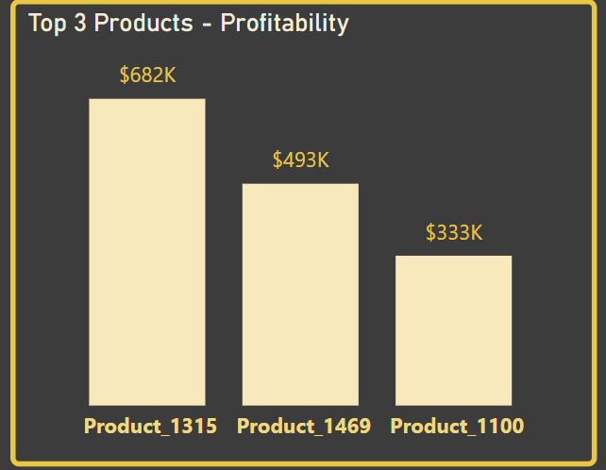
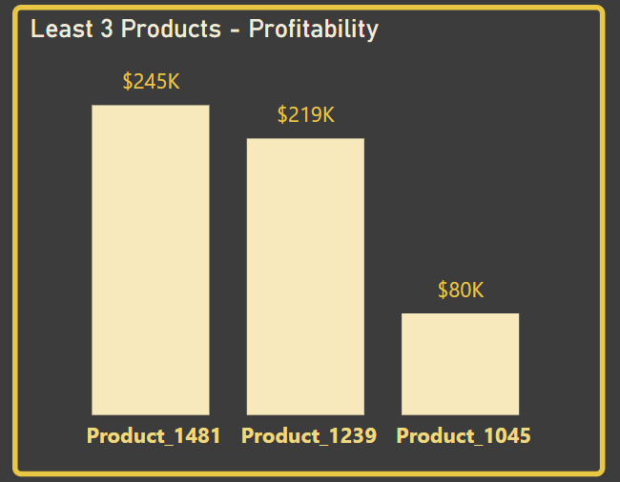
1. Profitability Analysis: - Top 3 Most Profitable products include: Product 1315, Product 1469 & Product 1100. - The 3 least Profitable products include: Product 1481, Product 1239 & Product 1045.
Recommendation:
Increase the production and marketing efforts for the top performing products and investigate the reasons for the low profitability for the products that aren’t performing well; Cost-reduction strategies, price increases, or product discontinuation should be considered for such products.

Slide 7
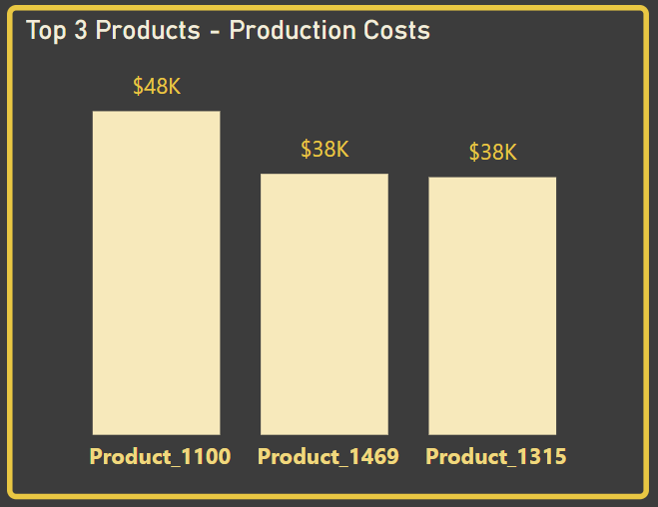
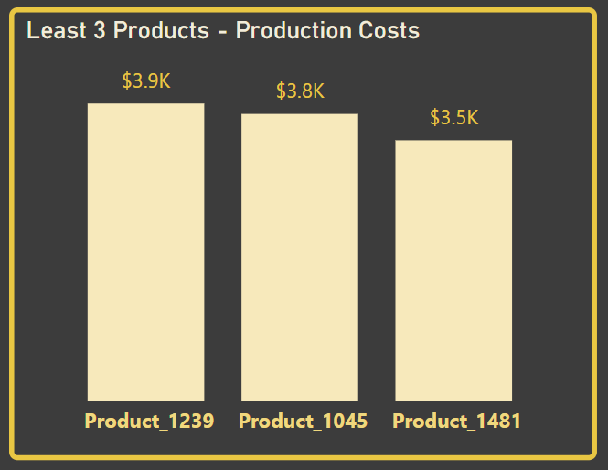
2. Production cost analysis: The Top 3 Most Expensive Products to produce are also the top 3 most profitable products while The 3 least Expensive products to produce are the least 3 profitable products, this suggests a potential correlation between production cost and profitability.
Recommendations: Investigate and implement cost-reduction strategies for high-cost products like 1100, 1469, and 1315. This could involve streamlining production lines, sourcing cheaper materials, or improving manufacturing efficiency. Also explore alternative manufacturing methods for high-cost products.

Slide 8
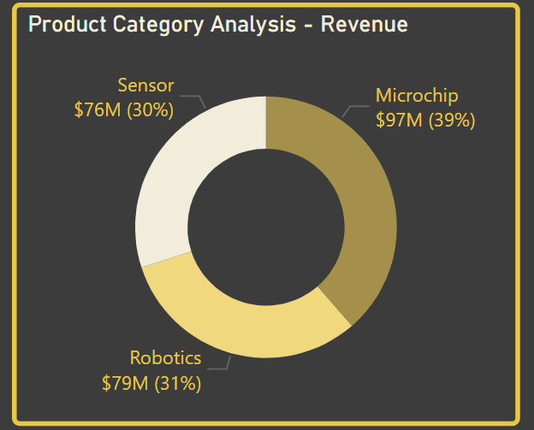
3. Revenue Analysis by Product category: The category with the highest revenue generation was Microchip followed by Robotics and Sensor.
Recommendations: (i) Focus on expanding the Microchip market by investing in research and development to enhance existing microchip technology and develop new, innovative products. (ii) Explore growth opportunities in Robotics: Identify and capitalize on emerging trends in robotics, such as artificial intelligence and automation. (iii) Further analysis is needed to find out the reasons for lower Sensor revenue. We should check whether this is due to lower demand, lower prices, or other factors.

Slide 9
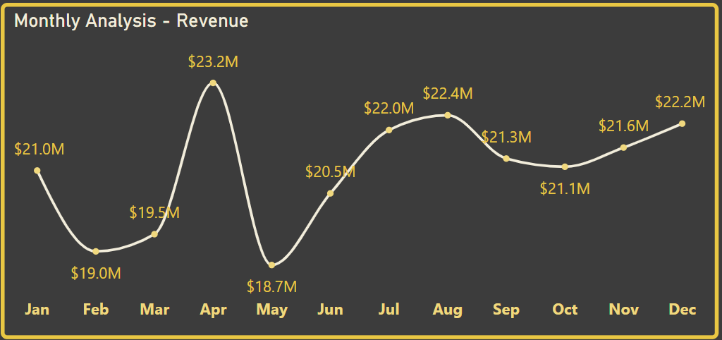
4. Revenue Analysis by month: The month with the highest revenue generation was April with $23.2M, followed by Aug with $22.4M and Dec with $22.2M while the least revenue was generated in May with $18.7M. This indicates some sort of seasonality in demand.
Recommendations: (i) Adjust production and inventory levels to align with seasonal demand fluctuations. (ii) Develop targeted marketing campaigns during peak seasons to capitalize on increased demand. (iii) Investigate the reasons for lower demand in May and implement strategies to mitigate this seasonal dip.

Slide 10
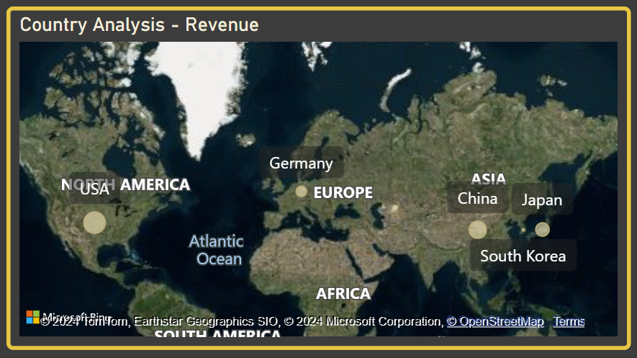
5. Revenue Analysis by Region & Country: The region with the highest revenue generation is Asia pacific with $150M, followed by North America with $52M and Europe with $50M. By country; USA had the highest revenue generation with $52M, followed by China with $51M, Japan with $50M and Germany with $49.7M while South Korea generated the least revenue with $49.2M.
Recommendations:
Look into expanding market share in Asia Pacific by Exploring new partnerships, establishing a stronger local presence, establishing new locations within the region and tailoring marketing strategies to the specific needs of Asian markets.
Investigate the reasons for lower revenue in South Korea: Analyze competitors to see what they are doing better, customer preferences, and market entry barriers.
In the regions/countries performing well, techtronix should focus on strengthening brand presence through targeted marketing both online/offline, continuously work on improving and diversifying products & strengthening customer service relationships.

Slide 11
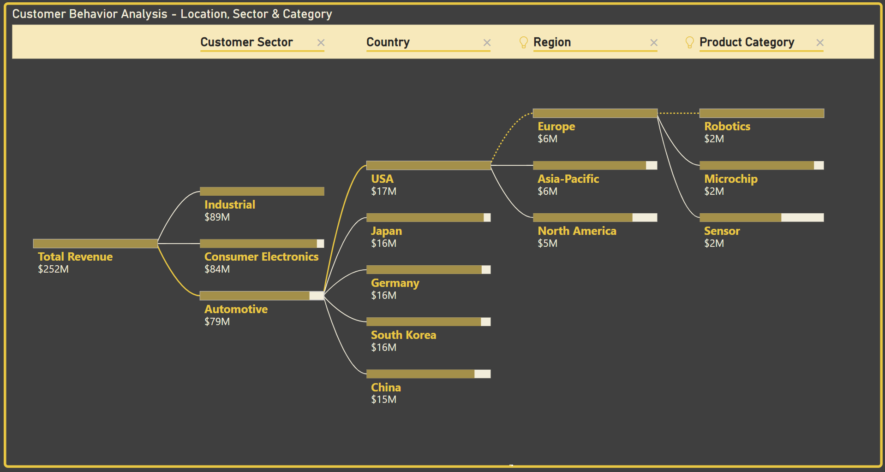
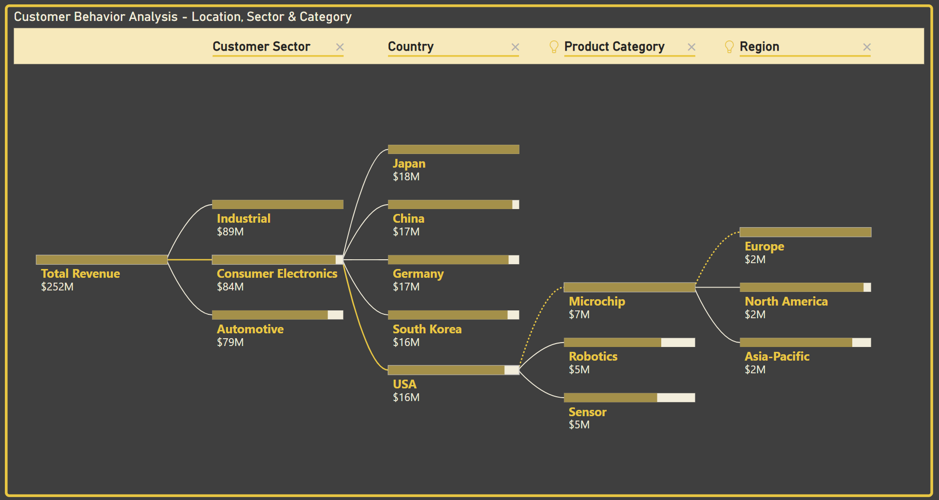
6. Analysing customer behaviour based on location, products, customer sector & product category: - In the Automotive sector, USA generated the highest revenue with $17M and Product 1315 was the most profitable ($204k). - In the Consumer Electronics sector, Japan generated the highest revenue with $18M and Product 1469 was the most profitable ($292k).

Slide 12
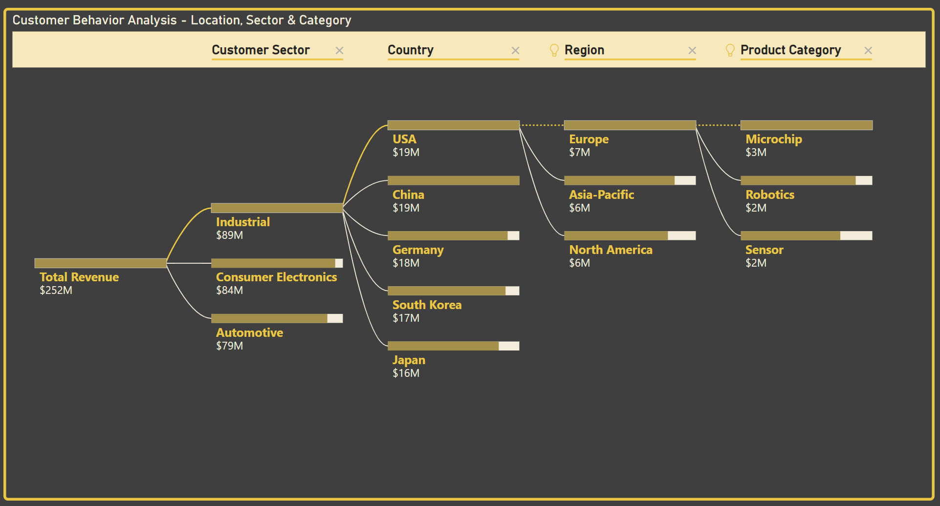
- In the Industrial sector, USA generated the highest revenue with $19.2M and Product 1100 was the most profitable ($133k). In all sectors Microchip generated the highest revenue and sensors generated the least revenue. The most profitable sector is the Industrial sector, it also generated the highest profit.
Recommendations:
Tailor marketing, production and sales efforts to the specific needs and preferences of each sector.
Develop targeted product offerings for each sector to maximize market penetration.
Analyse customer feedback to identify areas for product improvement and enhance customer satisfaction.

Slide 13
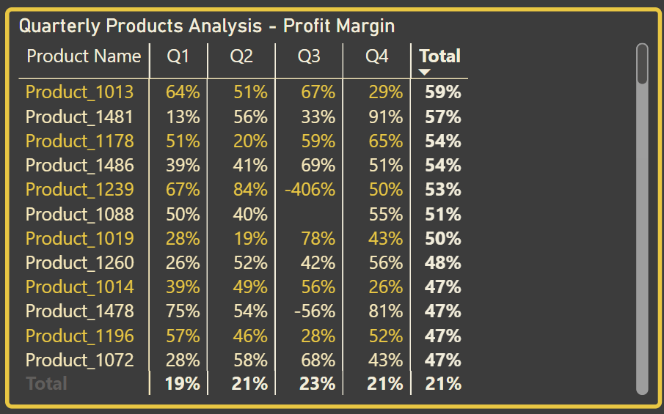
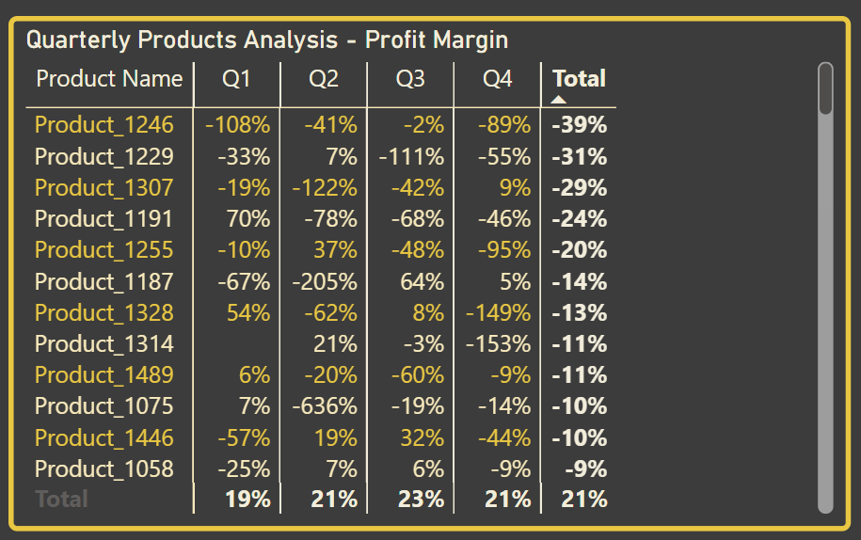
7. Profit Margin analysis by products: Product 1013 had the highest profit margin (59%) while over 30 other products had below 0% profit margin with product 1246 being the lowest (-39%).
Recommendations:
Focus on improving the profitability of products with low or negative margins.
Investigate the reasons for low profitability and implement corrective actions, such as cost reduction, price increases, or product discontinuation.

Slide 14
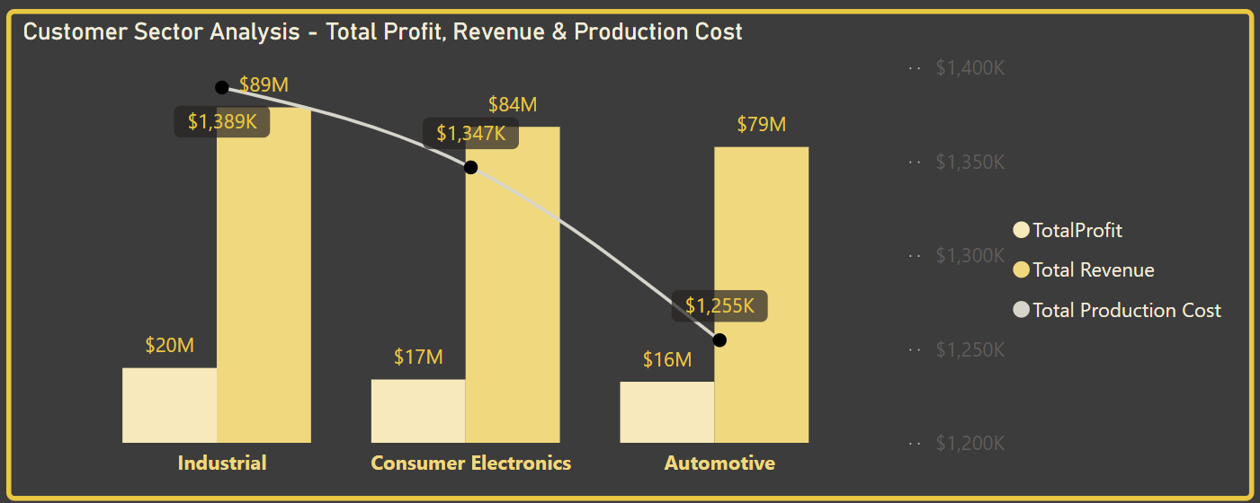
8. Analysing Customer sector by total revenue, profit & production cost: The Industrial sector leads with revenue $89m, Profit $20M and the total production cost $1.389M, The consumer electronics sector generated a revenue of $84m, Profit $17M and the total production cost was $1.347M and the Automotive sector generated a revenue of $79m, Profit $16M and the total production cost was $1.255M.
Recommendations:
Continue dominating the industrial sector by creating more tailored products for specific industrial sectors like energy, logistics, etc, continue establishing and fostering strong customer service relations and strengthen marketing strategies in this sector.
Explore opportunities to expand market share in the Consumer Electronics and Automotive sectors, leverage existing strengths to develop more innovative products in these sectors and also conduct a customer survey to figure out customer preferences in these sectors.

Slide 15
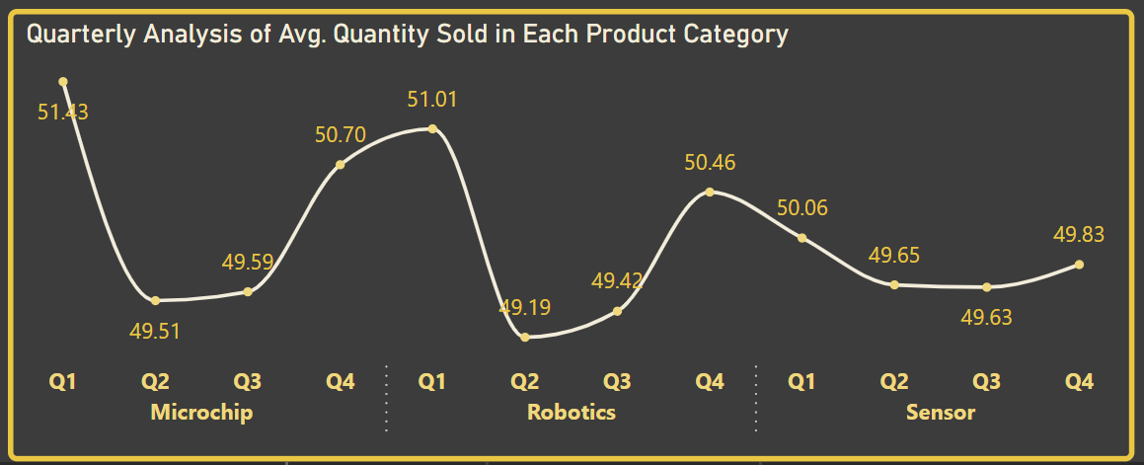
Quarterly Avg qty of products sold Analysis by product category: All sectors experienced the highest average sales in Q1.
Recommendation: (i) Analyse the factors contributing to higher sales in Q1 and leverage these insights to improve sales performance in other quarters. (ii) Develop strategies to maintain high sales levels throughout the year.

Slide 16
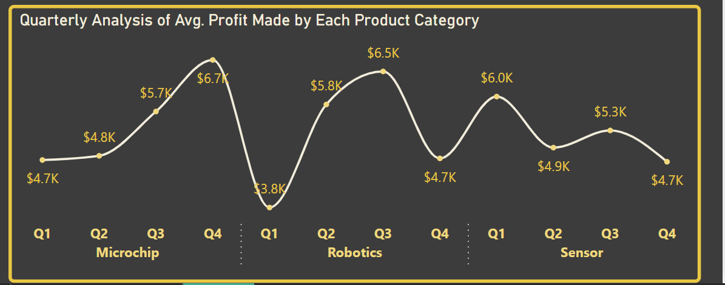
Quarterly Avg profit analysis by product category: Profitability varies across quarters for each product category.
Recommendation: Analyse the factors contributing to higher profits in specific quarters and implement strategies to maintain or improve profitability throughout the year.

Slide 17
DATA ANALYSIS & FINDINGS (B) Expansion/Growth Opportunities

Slide 18
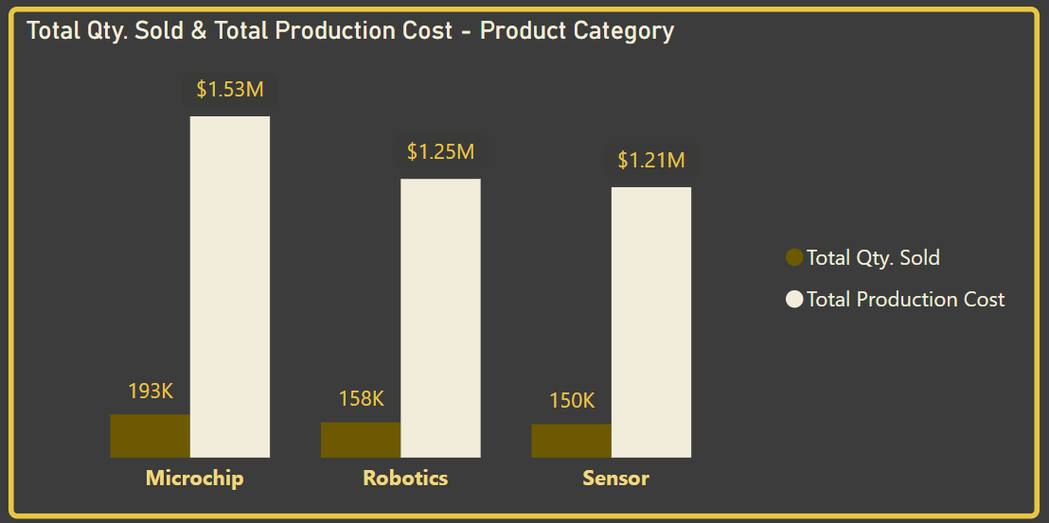
Analysing total quantity sold & production cost by product category: Microchips have the highest sales volume, followed by Robotics and Sensors. Production costs are highest for Microchips, likely reflecting their complexity and higher component costs.
Growth Opportunity Recommendations: (i) Focus on Microchip Efficiency: Despite higher production costs, Microchips generate the highest sales volume. Focus on optimizing production processes to improve cost-effectiveness while maintaining quality and performance. (ii) Diversify Product Portfolio: While Microchips drive sales, consider expanding the Robotics and Sensor product lines with higher-margin products to improve overall profitability.

Slide 19
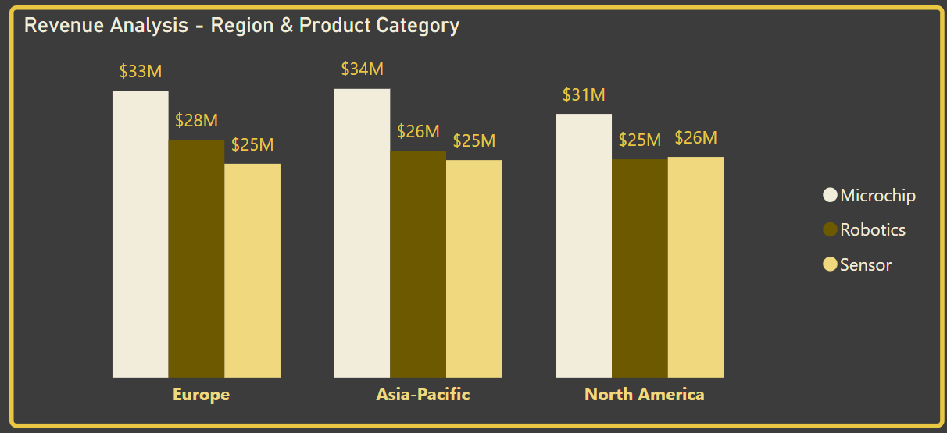
2. Revenue analysis by region & product category: Microchips consistently generate the highest revenue across all regions, indicating strong market demand.
Growth Opportunity/Recommendations: Maintain strong market position in Microchips across all regions while exploring growth opportunities in Robotics and Sensors, particularly in emerging markets within the regions. Also explore opportunities to expand sales in all regions for robotics and sensors categories.

Slide 20
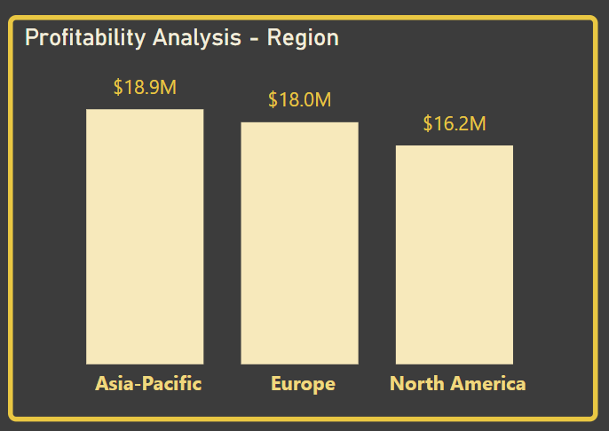
3. Profitability analysis by region: Asia Pacific generates the highest profit, followed by Europe and North America.
Growth Opportunity/Recommendations: (i) Asia Pacific Focus: Continue to prioritize market expansion in Asia Pacific, focusing on high-growth sectors and optimizing operations to maintain profitability. Also consider other hot locations within the region to drive revenue (ii) Market Diversification: Explore new market opportunities in other regions with high growth potential, such as Latin America and Africa.

Slide 21
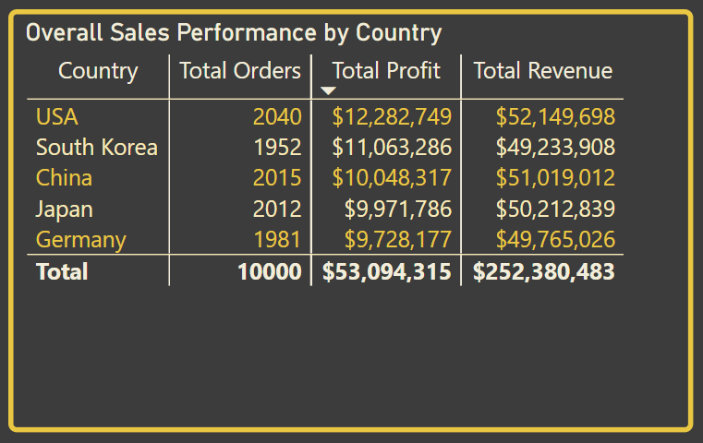
4. Analysing the sales performance by country: The USA demonstrates strong overall performance with the highest number of orders, revenue, and profit. Germany lags behind in terms of sales and profitability.
Growth Opportunity/Recommendations: (i) Maintain strong market position in the USA while exploring opportunities to expand into new market segments and customer groups. (ii) Investigate the reasons for lower performance in Germany (e.g., competition, market entry barriers, customer preferences). Implement targeted strategies to improve market penetration and profitability in this region.

Slide 22
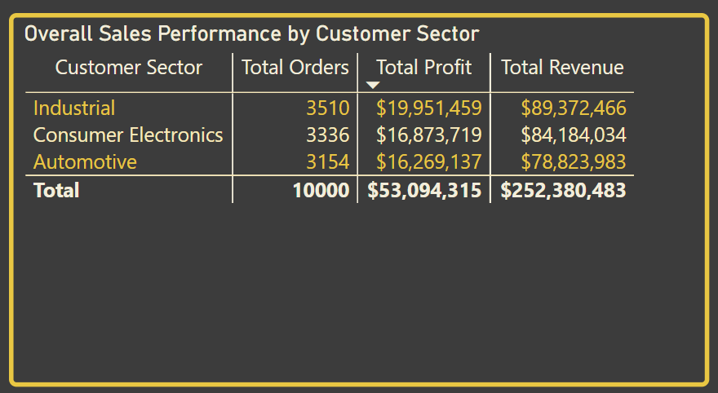
5. Analysing the sales performance by customer sector: The Industrial sector leads in terms of orders, revenue, and profit.
Growth Opportunity/Recommendations: (i) Continue to prioritize the Industrial sector as a key growth area, focusing on developing innovative solutions for this market. (ii) Consumer Electronics and Automotive: Explore new market entry strategies and develop targeted product offerings to increase market share in these sectors.

Slide 23
ACTION PLANS
By implementing these strategies below, Techtronix will effectively achieve its business goals and drive sustainable growth:
Target Growing Markets: Prioritize expansion in Asia Pacific and other regions with high growth potential, while maintaining a strong presence in existing markets like the United States.
Offer a Wider Range of Products: Expand the product portfolio with high-margin products, particularly in Robotics and Sensors, to complement the existing strong performance of Microchips.
Improve Production Processes: Optimize production processes to improve cost-effectiveness and reduce waste.
Focus on Customer Needs: Gather and analyze customer feedback to identify areas for product improvement and enhance customer satisfaction. The company will tailor marketing and sales efforts to the specific needs and preferences of each customer segment.
Use Data to Guide Decisions: Utilize data analytics to identify trends, forecast demand, and optimize inventory levels. The company will implement a robust data management system to track key performance indicators (KPIs).
Invest in Innovation: Continuously invest in research and development to develop cutting-edge technologies, stay ahead of the competition, and maintain a competitive advantage.

Slide 24
CONCLUSION
Techtronix Innovations is at a crucial point in its journey. By leveraging data-driven insights, optimizing operations, and embracing innovation, the company can achieve significant growth and success. This strategic approach will solidify it’s position as a leader in the high-tech industry, delivering cutting-edge solutions that transform the world!
THANK YOU!!

